Slide 1
Impact of the COVID-19 Pandemic on the
Airline Industry
Dave, Danny, Jayden, Max, Palida

Slide 2
OVERVIEW
01
02
SCOPE OF THE PROJECT
PURPOSE OF THE PROJECT
To discover if there is any correlation between major disease outbreaks and flight volume within the 5 most frequented airports in the U.S.
To understand the nature of disease outbreak and how it has impacted the economy, specifically, the airline industry.

Slide 3
OUR APPROACH
Initial interest in the airline industry
COVID-19 has tremendously impacted air travel around the world
Air carriers are one of the major modes of transportation in the U.S.
Focus on the current pandemic situation and its impact on flight volume in the U.S.
Comparing the COVID-19 pandemic to the Influenza outbreak

Slide 4
WORK BREAKDOWN
MAX
JAYDEN
DANNY
PALIDA
DAVE
Observing the numbers of departure seats between 2016 and 2020.
Comparing the flight volume data from 2019 to 2020 (Covid-19) and 2017 to 2018 (Influenza)
Observing the flight volume in the 5 major U.S. airports
Exploring the COVID-19 data and understanding the statistics
Exploring the trend of Influenza pandemic
Notes:
DIscuss where and how you found the data you used

Slide 5
DATA MANIPULATION
Data Sources:
Data Cleaning Process:
Center for Disease Control
World Health Organization
Kaggle
Bureau of Transportation
Federal Aviation Administration
Data conversion
Data Merge
Fill-in missing values
Unit conversion
File conversion
Excess columns removal
Notes:
• Data exploration and clean process (accompanied by your Jupyter Notebook) - for example, how you went about finding "dirty" data and how you removed it

Slide 6
OVERVIEW OF THE ANALYSIS
LARGER VIEW
FOCUSED VIEW
MEDIUM VIEW
Looking at the general view of the departure seats in 5 major U.S. Airport, over 5 years
Observing for the impact of Influenza and COVID-19 pandemic in 2018 & 2020 (by specific months)
Discovering the impact of Influenza and COVID-19 pandemic in 2018 & 2020 (by specific months)

Slide 7
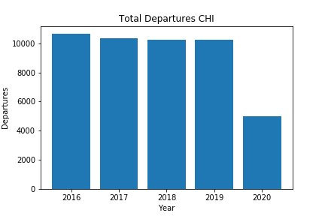
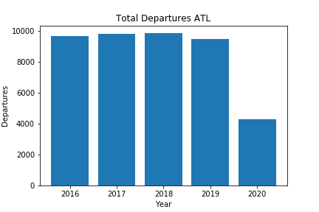
ANALYSIS: TOTAL DEPARTURES
Significant drop
Significant drop

Slide 8
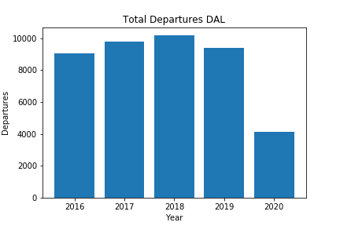
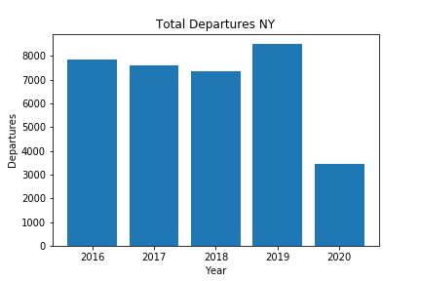
ANALYSIS: TOTAL DEPARTURES
Significant drop
Significant drop

Slide 9
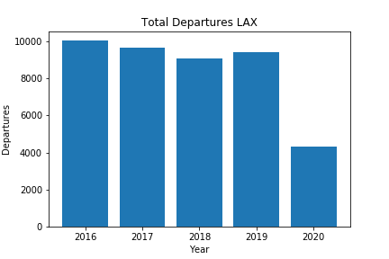
ANALYSIS: TOTAL DEPARTURES
Significant drop

Slide 10
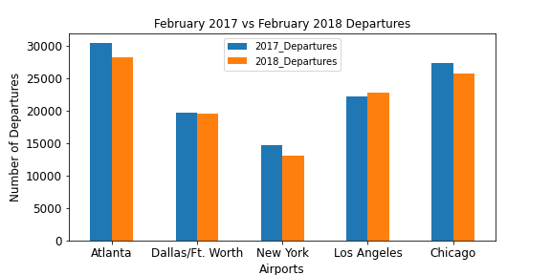
ANALYSIS: 2017 to 2018 Flight Volume

Slide 11
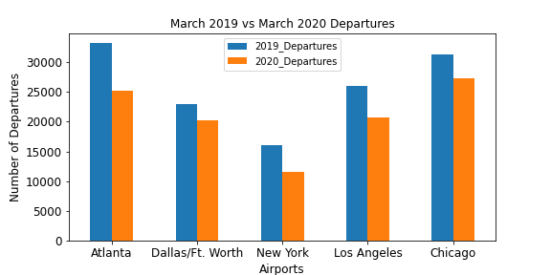
ANALYSIS: 2019 to 2020 Flight Volume

Slide 12
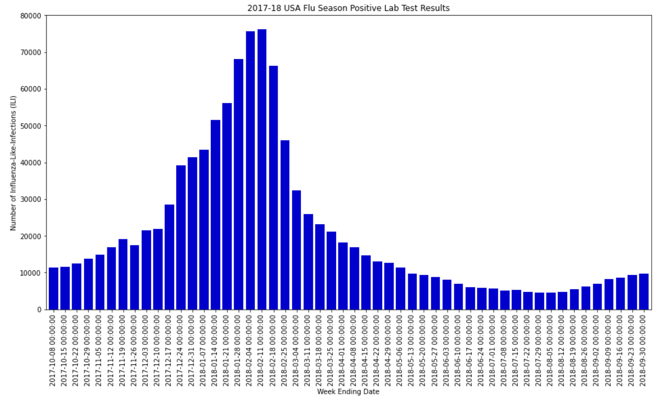
ANALYSIS: 2017-2018 U.S.A. Flu Season
The cases peaked during February 2018

Slide 13
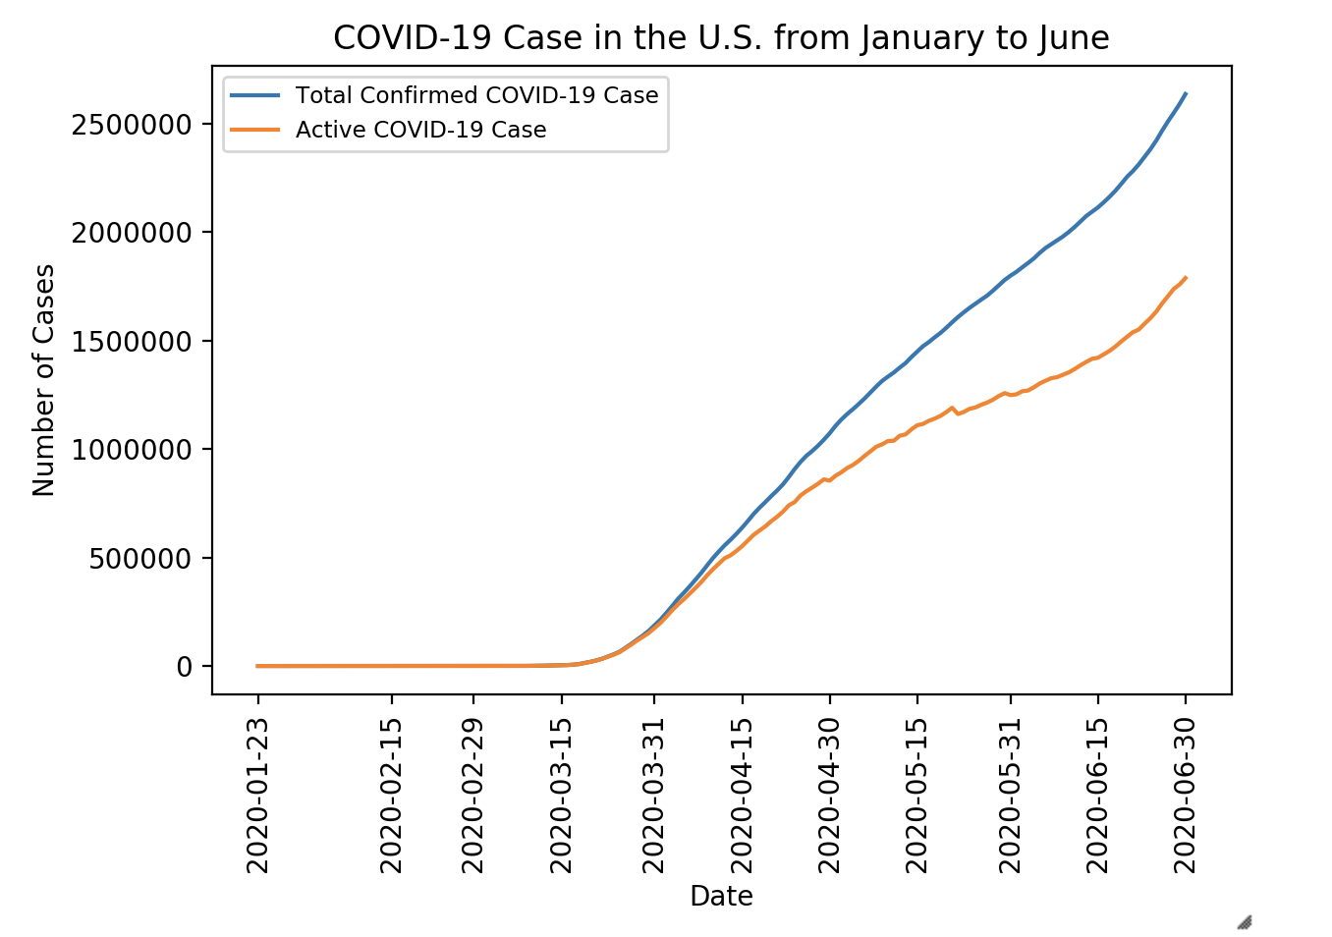
ANALYSIS: COVID-19 Cases in the U.S.
Significant increase
in cases

Slide 14
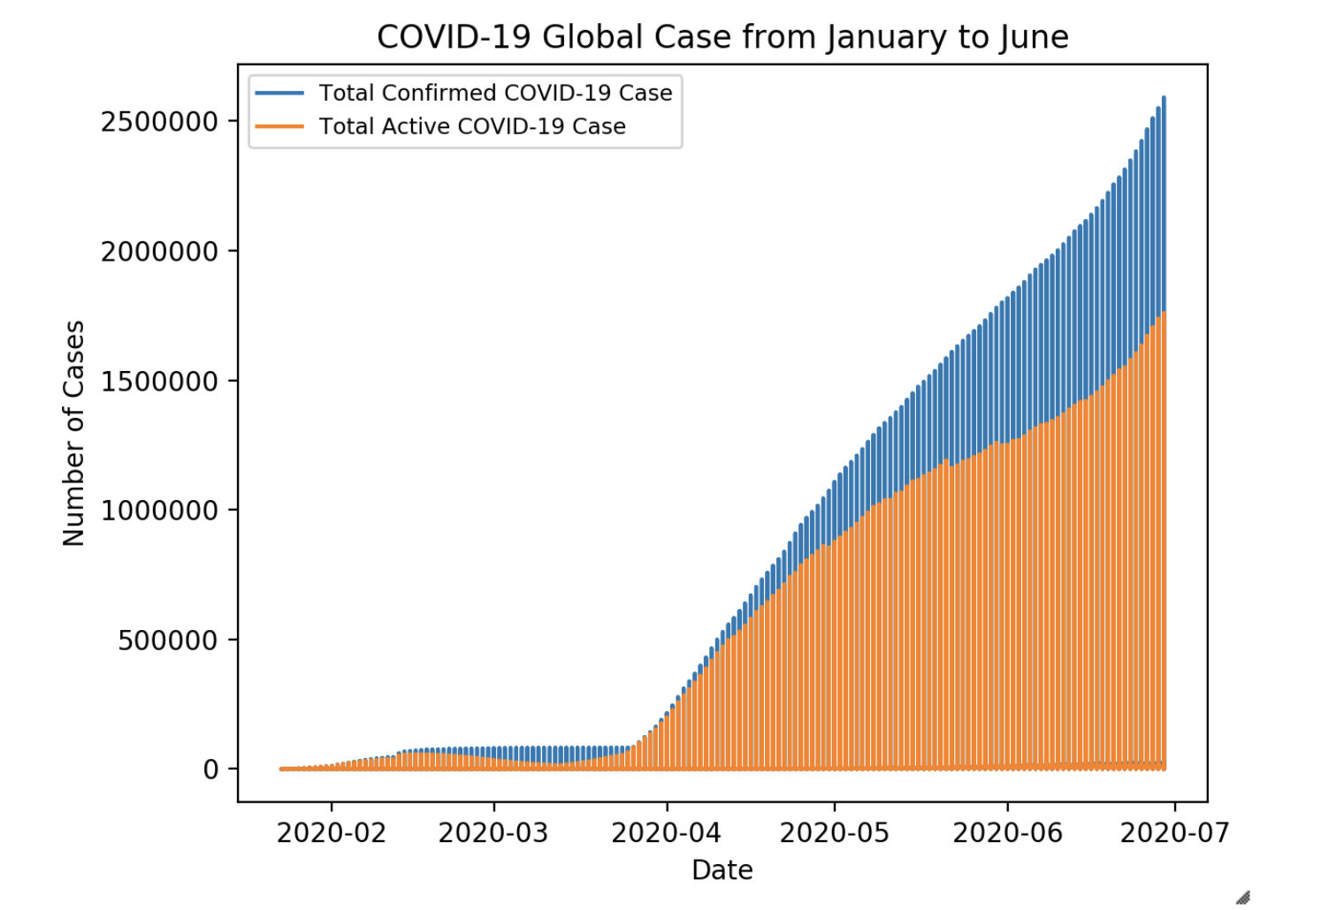
ANALYSIS: COVID-19 Global Cases
The global trend shares similar pattern as the U.S. trend

Slide 15
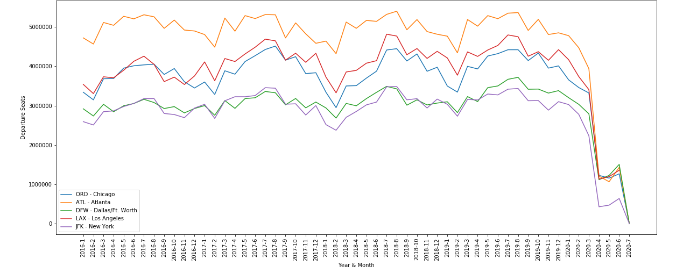
ANALYSIS: Departure Seats vs. Virus Outbreaks
Significant Drop due to COVID-19 Pandemic
‘17 - ‘18 U.S.A. Flu Season

Slide 16
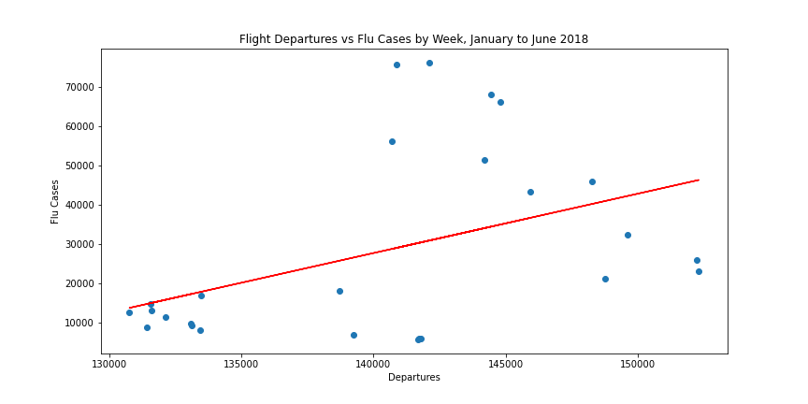
Flu Cases vs Departures
Correlation
r= 0.44
The correlation value between the number of flu cases and number of departures is weak/moderate

Slide 17
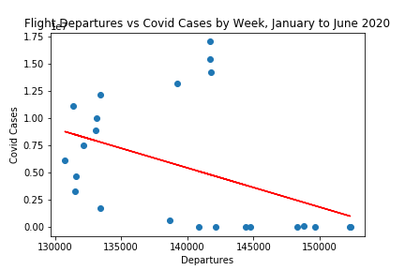
Covid-19 vs Flight Departures
Correlation
R = -0.43
The correlation value between the number of flu cases and number of departures is weak/moderate

Slide 18
CONCLUSION
There was a significant impact of COVID-19 on flight volume in 2020.
There was a moderate positive correlation between the change in flight departures from the 5 major US airports and the US influenza outbreak in 2018. Where as the was a negative moderate correlation between flight departures and the COVID-19 pandemic in the United States.

Slide 19
THANK YOU

